Slide 1
Test Automation
Madona Halim

Slide 2
Agenda
Introduction to Test Automation
Benefits of Test Automation
Automation testing tools ( Selenium )
Maven
Testing Framework (TestNG)
Page Object Model(POM)
Cucumber.

Slide 3

Test Automation
Test automation is the practice
of automatically reviewing and
validating a software product.

Slide 4
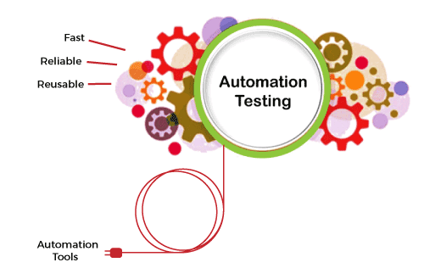
Benefits of Test Automation
Save Time
Repeatability
Reusable
Speed
Increase test coverage

Slide 5

Selenium
Set of tools to support test automation
for web applications.
Dealing with HTML, No backend
Allow for locating elements and then
comparing expected results and actual results.

Slide 6
Selenium Features
Open Source
Support Cross Browser
Support Several Programming Languages: Java, C# , Python and Ruby,..etc.
Record/Playback (SeleniumIDE)
Inbuilt Reporting

Slide 7
Selenium Components
Selenium IDE: Plugin in Firefox only for record/playback.
Selenium Remote Control(RC): Run code in other servers.
Selenium Web Driver: Accept commands then send them to browsers.
Selenium Grid: Run scripts in multi browser in parallel

Slide 8
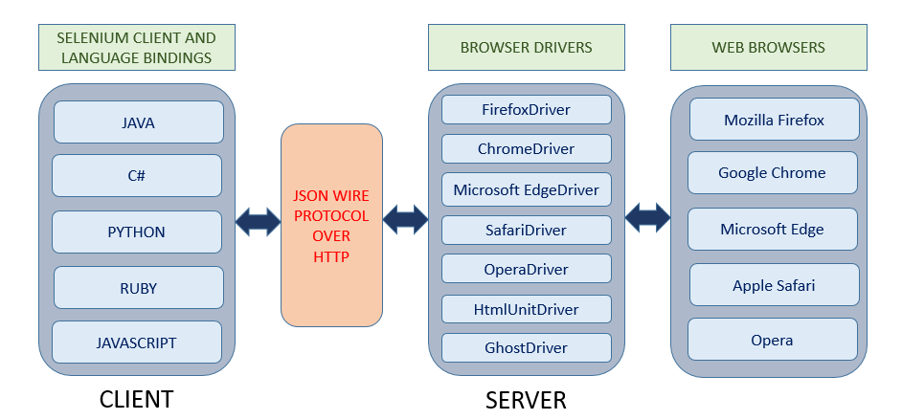
Selenium WebDriver Architecture

Slide 9
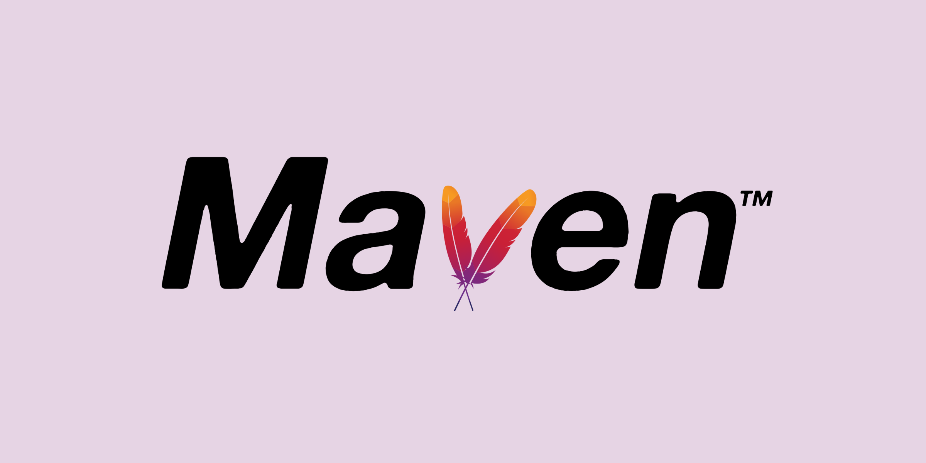
Maven
Maven is a powerful project management tool
that is based on POM (project object model).
Adding jars files automatically.
Managing dependency using pom.xml.

Slide 10
Testing Framework (TestNG)
TestNG is a testing framework introducing some new functions that make automation more powerful and easier to use.
TestNG is designed to cover all categories of tests: unit, functional, end-to-end, integration
An annotation is a tag that provides information about the method, class, and suite. It helps to define the execution approach of your test cases and the different features associated with it.

Slide 11
POM
Page Object is a Design Pattern that has become popular in test automation to enhance test maintenance and reduce code duplication.

Slide 12
Cucumber
cucumber is a testing tool that supports Behaviour Driven Development (BDD). It provides a way to write tests that can be even understood by non-technical folks. Cucumber is written in Ruby.

